Slide 1
Image Recovery in the Infrared Domain via Path-Augmented
Compressive Sampling Matching Pursuit
CVPR 2019
Perception Beyond the Visible Spectrum
June 16, 2019
Tegan H. Emerson*, Colin C. Olson, Anthony Lutz
US Naval Research Laboratory
Optical Sciences
Washington, DC

Slide 2
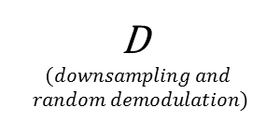
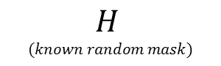
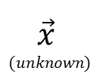
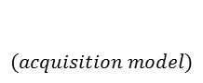
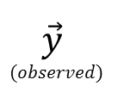
Motivation and Acquisition Model
$$(acquisition model)$$
Motivation: The cost of high-res IR focal plane arrays is prohibitive and labeled high-res IR images are rare
FL
FL
FL
FL
$$\vec{y}$$
$$(observed)$$
D
$$(downsampling and$$
$$random demodulation)$$
$$\vec{x}$$
$$(unknown)$$
$$H$$
$$(known random mask)$$
Fourier Plane
Goal: Use our knowledge of the acquisition model together with the theory of compressive sensing to recover higher-resolution images from lower-resolution focal plane arrays

Slide 3
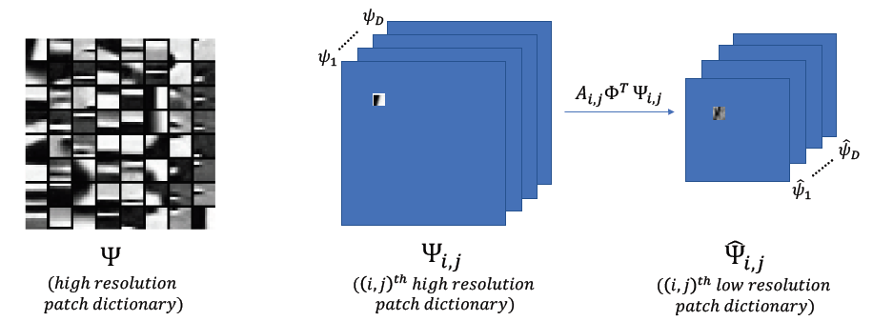
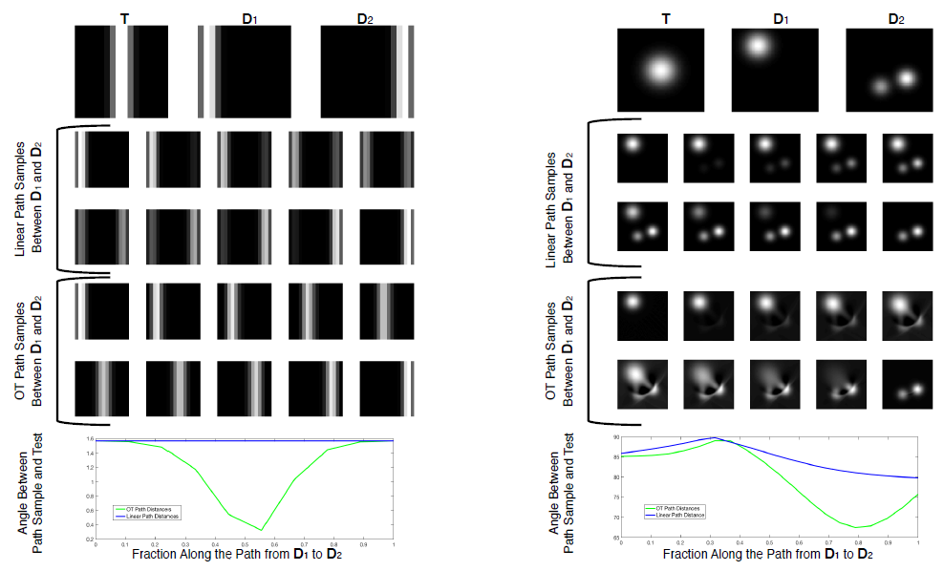
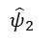
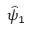
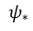
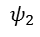
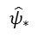
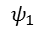
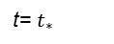
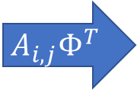
Path-Augmented Image Recovery
Builds on the foundation of the well-known CoSaMP algorithm
Uses a path-augmentation step to search for more representative atoms
$$ψ_{1}$$
$$ψ_{∗}$$
$${\hat{ψ}}_{1}$$
$${\hat{ψ}}_{∗}$$
$$A_{i,j}Φ^{T}$$
t=0
…..
t= $t_{∗}$
$${\hat{ψ}}_{2}$$
$$ψ_{2}$$
t=1
…..
Samples along the 2-Wasserstein geodesic between the two most-correlated high-resolution dictionary patches.

Slide 4
Results and Future Directions
We compared PAIR to standard CoSaMP using three different performance metrics: PSNR, SSIM, and PEA which is a measurement of the edge fidelity between the true and the recovered image.
For all three metrics PAIR yields improved performance for low sparsity levels.
Results were obtained utilizing an unsophisticated patch-stitching algorithm, we believe better stitching will improve overall performance.
In future we’ll compare PAIR to deep learning frameworks for high-resolution image recovery.

Slide 5
SurReal: Frechet Mean and Distance Transform for Complex-Valued Deep Learning
Rudrasis Chakraborty, Jiayun Wang, and Stella X. Yu

Slide 6
Introduction
We develop a novel deep learning architecture for naturally complex-valued data, which is often subject to complex scaling ambiguity.
With the polar form of a complex-valued number, the general group (G) that acts in this space is the product of planar rotation and non-zero scaling.
This allows us to develop
a) a convolution using weighted Fréchet mean (wFM) on a Riemannian manifold (equivariant to G).
b) a fully connected operator using the distance to the wFM (invariant to G).
4. On MSTAR data, our model achieves 98% target classification accuracy with only 9% of the parameters of the baseline model.

Slide 7
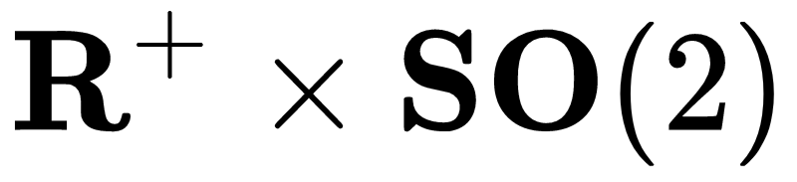
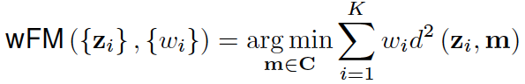
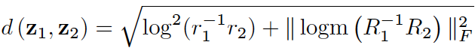
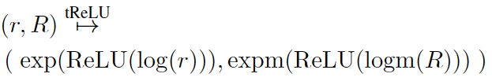
Key Components of our model
Represent complex numbers as
Define convolution as
Where,
3. Define tReLU as

Slide 8
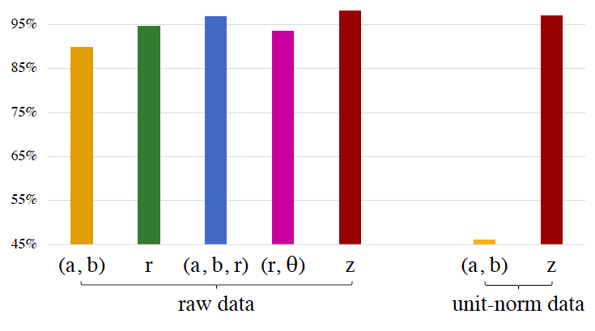
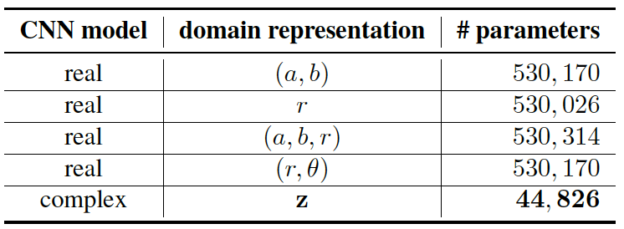
Experimental Results

Slide 9



SAR Image Classification Using Few-shot Cross-domain Transfer Learning
Mohammad Rostami, Soheil Kolouri, Eric Eaton, Kyungnam Kim
© 2019 HRL Laboratories, LLC

Slide 10
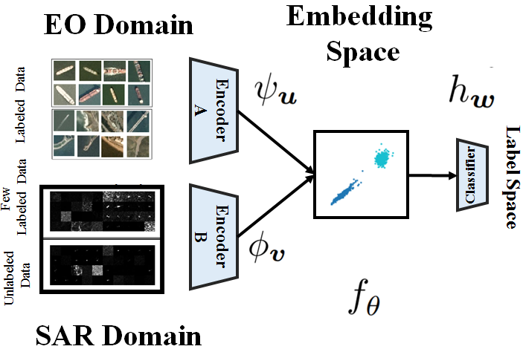
Summary
We develop a method to train deep networks for SAR domain problems, where labeled data is scarce.
Our idea is to transfer knowledge from EO domain, where it is easy to collect labeled data.
We learn an invariant embedding space, where the distributions of both domains are aligned class-conditionally
© 2019 HRL Laboratories, LLC

Slide 11
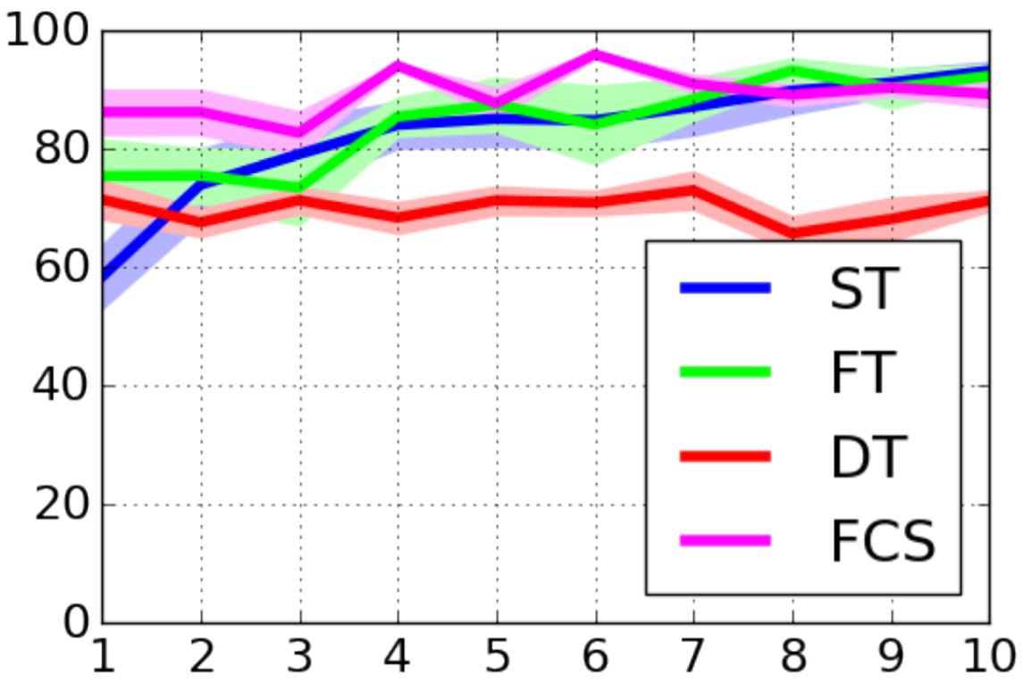
Results
We compare our results (Few-shot SAR image classification) against:
Supervised training (no knowledge transfer)
Fine tuning (prior methods)
Direct transfer
In the problem of SAR ship image classification
© 2019 HRL Laboratories, LLC

Slide 12
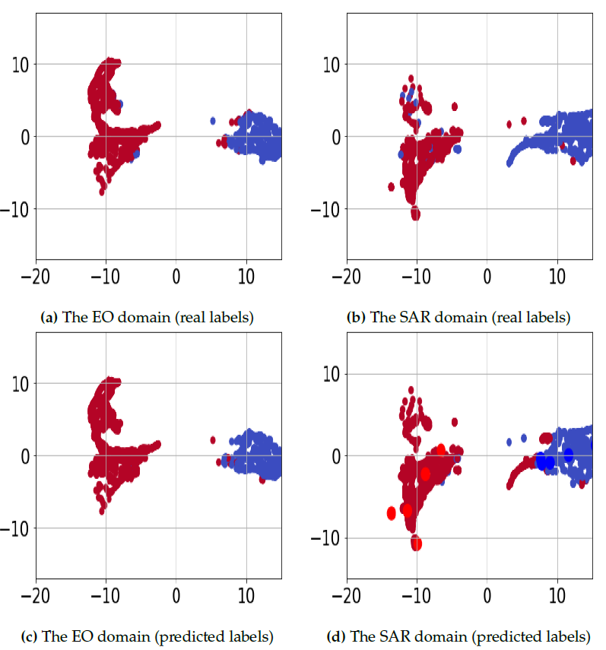
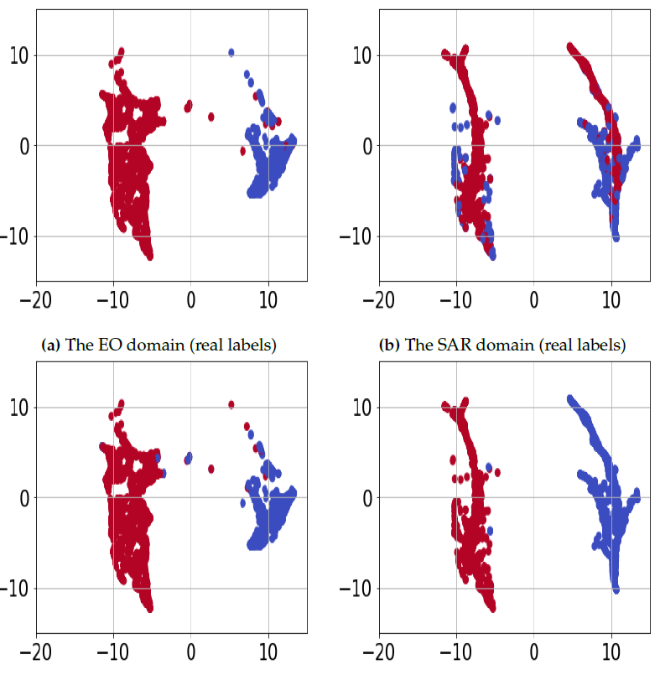
Results
t-SNE visualization of data in the embedding space
Ablation Study
© 2019 HRL Laboratories, LLC

Slide 13
Generative Adversarial Networks for Spectral Super-resolution and Bidirectional RGB-to-multispectral Mapping
Kin Gwn Lore¹, Kishore Reddy¹, Michael Giering¹, Edgar A. Bernal²
¹{lorek, reddykk, gierinmj}@utrc.utc.com
²edgar.bernal@rochester.edu
¹ United Technologies Research Center
411 Silver Lane, East Hartford CT 06018
² University of Rochester
260 E. Main St., Rochester NY 14604
PBVS 2019 Workshop – CVPR 2019 – Long Beach
June 16, 2019

Slide 14
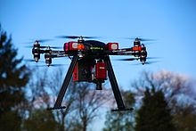
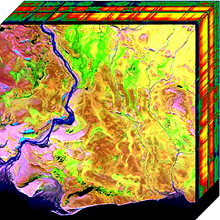
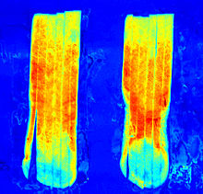
Introduction
RGB/Low-Res MSI to Hi-Res MSI
Problem: Full multispectral data cube may be expensive to obtain. Can we construct a “virtual sensor” to map RGB images to spectral information?
Solution: Multispectral image estimation from RGB image frames / low-res MSI
Benefits: Cost savings, less restrictive storage requirements
Hi-Res MSI to RGB
Problem: How to effectively fuse MSI images and represent RGB with good perceived visuals & RGB information?
Solution: Learn to fuse MSI into RGB with GANs
Benefits: Good visuals, good information content in each RGB channel for analysis tasks
Hyperspectral camera embedded on OnyxStar HYDRA-12 UAV from AltiGator.
Courtesy of Cargyrak, Creative commons license.
Aerial Hyperspectral Imaging
Courtesy of Dr. Nicholas M. Short, Sr. - NASA http://rst.gsfc.nasa.gov/ (Public domain)
Spectral imagining of potato strips showing invisible defects
Courtesy of SortingExpert. Creative Commons license.

Slide 15
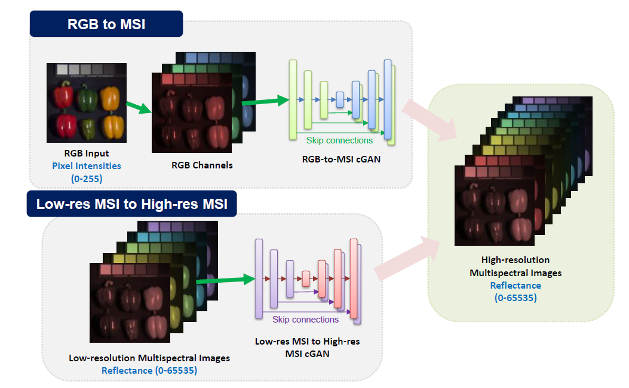
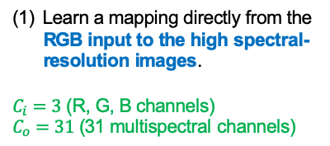
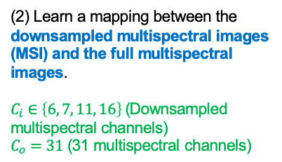
Problem Formulation
Source Domain: Pixel Intensity (0-255)
Learn a mapping directly from the RGB input to the high spectral-resolution images.
$C_{i}=3$ (R, G, B channels)
$C_{o}=31$ (31 multispectral channels)
(2) Learn a mapping between the downsampled multispectral images (MSI) and the full multispectral images.
$C_{i}∈\left\{6, 7, 11, 16\right\}$ (Downsampled multispectral channels)
$C_{o}=31$ (31 multispectral channels)
Source Domain: Reflectance (0-65536)

Slide 16
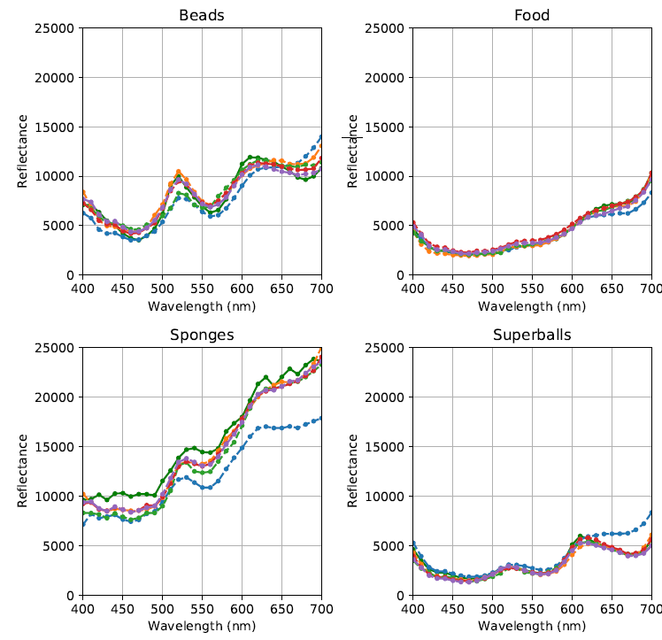
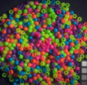
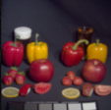
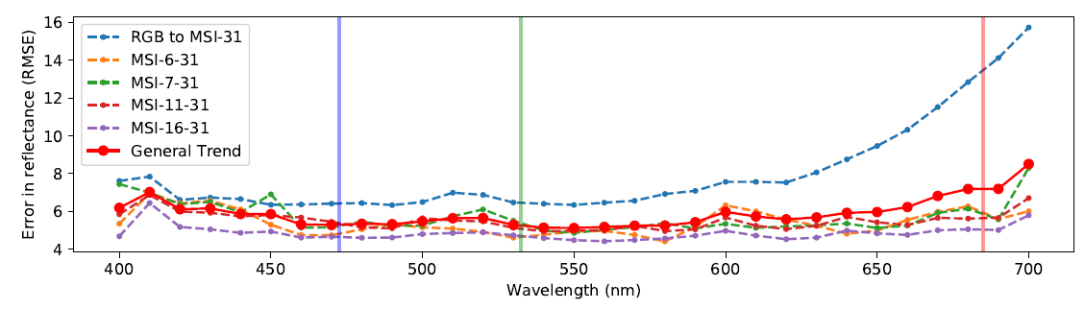
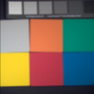
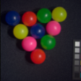
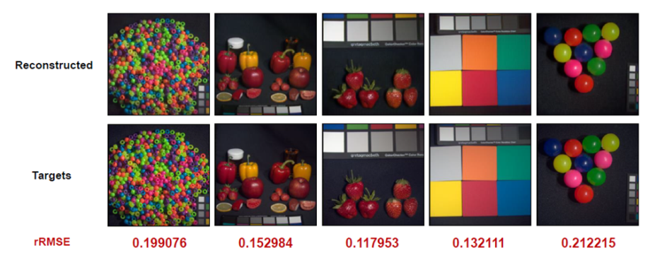
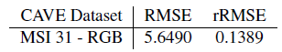
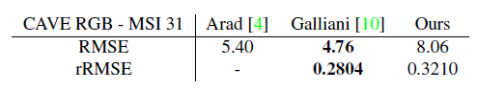
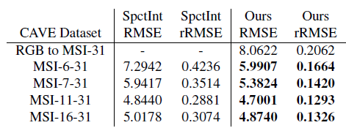
Results
From MSI/RGB to MSI
For more information, please visit our poster.
We’ll share more results & insights!
Domain gap
RMSE between reconstructed and ground truth images
From MSI to RGB
Within 2% error

Slide 17

Pedestrian Detection in Thermal Images using Saliency Maps
Debasmita Ghose*, Shasvat Desai*, Sneha Bhattacharya*, Deep Chakraborty*, Madalina Fiterau, Tauhidur Rahman
[16 June], 2019
* Authors contributed equally

Slide 18
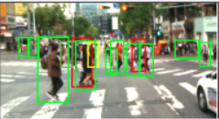
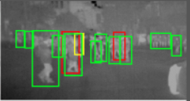
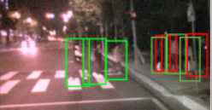
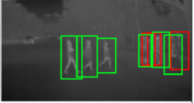
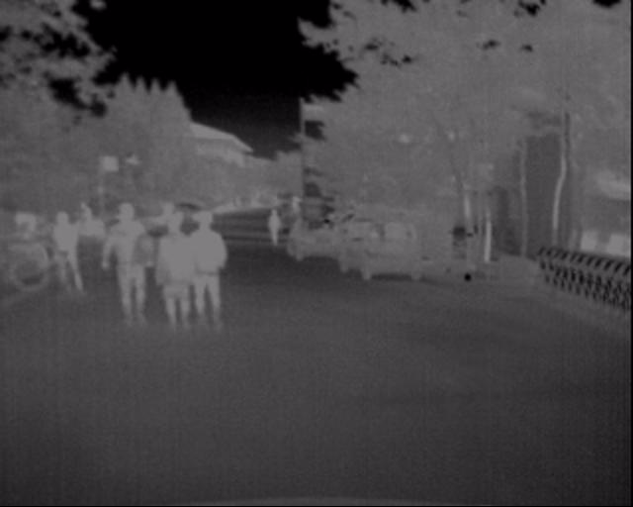
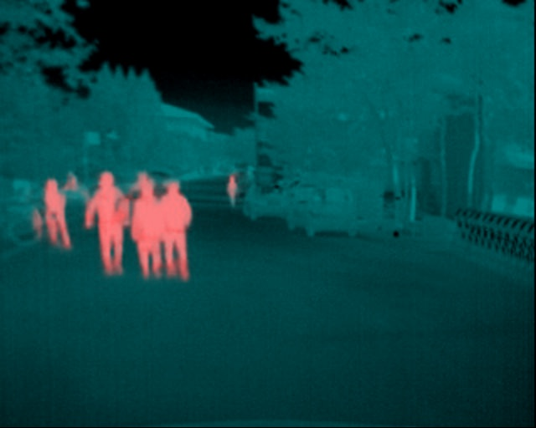
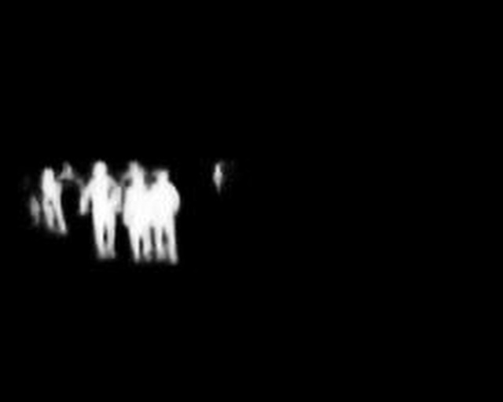
INTRODUCTION
${\text{Color}\text{−}\text{Thermal} \text{image} \text{pairs} \text{from} \text{KAIST} \text{Multispectral} \text{Pedestrian} \text{Dataset}}^{1}$
Day
Night
Thermal Images
Saliency Maps
+
=
Fused Image
1. Hwang, Soonmin, et al. "Multispectral pedestrian detection: Benchmark dataset and baseline." Proceedings of the IEEE conference on computer vision and pattern recognition. 2015.

Slide 19
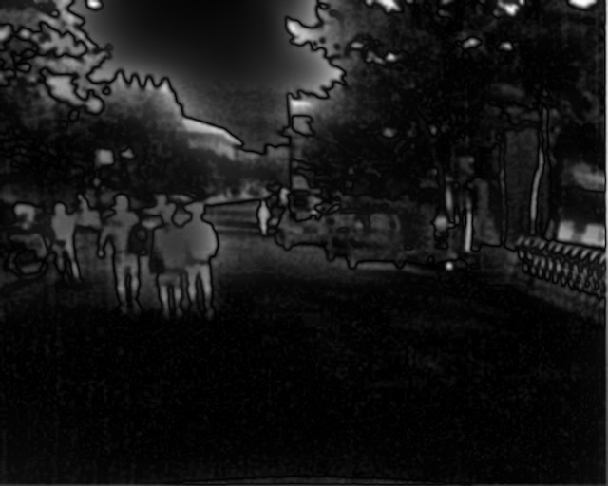
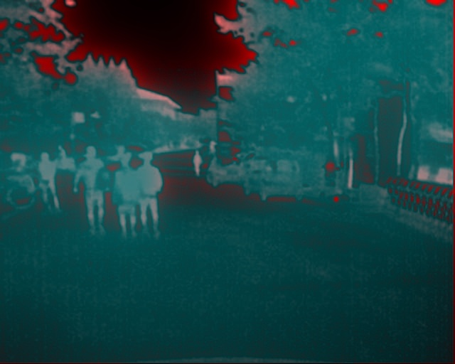










Methods
Saliency Map using OpenCV
Fused Image
Saliency Detector
+
Our Dataset
Thermal Image
Ground Truth Saliency Mask
Saliency Map from Deep Network
Fused Image
Detection
Fused Images
Fused Images
+
Faster RCNN
Faster RCNN

Slide 20




RESULTS
Why not use only Saliency Maps instead of augmenting the Thermal images with Saliency Maps?
Saliency Map
Thermal + Saliency
Saliency Map
Thermal + Saliency
Log Average Miss Rate
0.44
0.39
0.40
0.40
0.32
0.30
0.22
0.21

Slide 21



Borrow from Anywhere Pseudo Multi-modal Object Detection in Thermal Imagery Chaitanya Devaguptapu¹, Ninad Akolekar¹, Manuj M Sharma², Vineeth N Balasubramanian¹ ¹Indian Institute of Technology, Hyderabad, INDIA
²ANURAG-DRDO, INDIA

Slide 22
Key Ideas
The Need
Proposed Method
Thermal datasets low quality, small in size (95K images, KAIST)
Leverage large-scale RGB datasets
Paired RGB-Thermal data hard to collect
Can we generate RGB from thermal? How to use?
Should work with SOTA object detectors.
Borrow useful features from rich domains like RGB (9M images, Open Images)
Operate even when there are no paired thermal-RGB images
Generate pseudo RGB using GANs
Use multi-modal approach for object detection
Can be extended to any region CNN based object detector
Devaguptapu et al, Borrow from Anywhere, CVPRW PBVS 2019

Slide 23

Proposed MMTOD Framework
Devaguptapu et al, Borrow from Anywhere, CVPRW PBVS 2019

Slide 24





Results
Questions? Visit our poster, or
email us at
chaitanyadevaguptapu@iith.ac.in
or
vineethnb@iith.ac.in
Paper Link:
Results on KAIST dataset
Results on FLIR ADAS dataset
Single mode
MMTOD
GroundTruth
Results on using ¼ FLIR ADAS training set
arXiv id: 1905.08789
Devaguptapu et al, Borrow from Anywhere, CVPRW PBVS 2019

